Slide 1
Methods and Constructors:

Slide 2
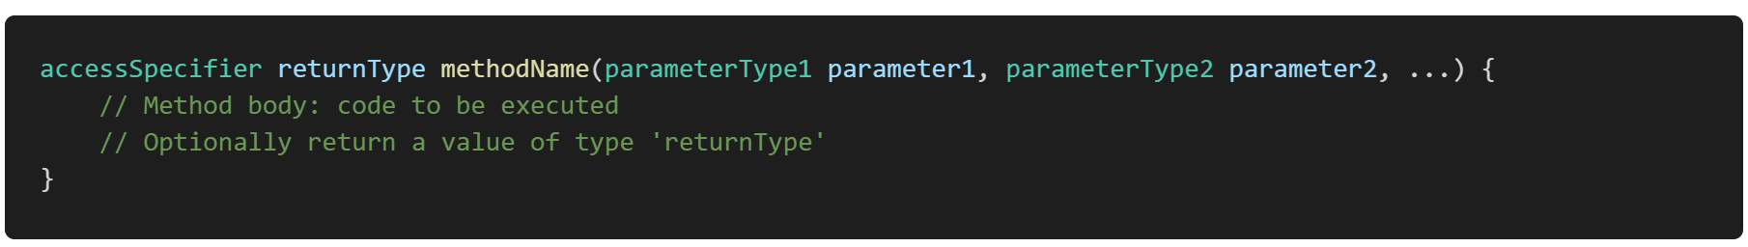
Method:
In Java, a method is a block of code that performs a specific task and can be executed when called upon. Methods are used to define the behavior of objects, perform operations, and structure the code in a modular and reusable way.
Components of a Method
Return Type: Specifies the type of value the method returns. If the method does not return a value, the return type is void.
Method Name: The name of the method, which is used to call it. Method names should be meaningful and follow camelCase convention.
Parameters (optional): A list of variables that the method can accept as input. Each parameter is defined by a type and a name. Parameters are optional; a method can have zero or more parameters.
Method Body: The block of code enclosed in curly braces {} that defines what the method does
Return Statement (optional): If the method has a return type other than void, it must include a return statement to return a value.

Slide 3
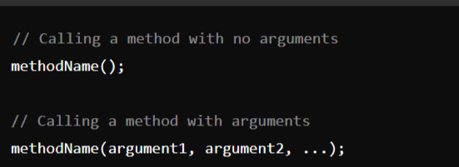
Calling a Method:
To call a method in Java, you use the method name followed by parentheses, which may include arguments if the method requires parameters. Methods can be called from within other methods or from different classes, depending on their visibility (access specifier).
Syntax:

Slide 4
Parameter Passing :
Java supports two types of parameter passing:
Pass by Value (the only parameter passing method in Java)
Pass by Reference (not directly supported in Java for objects, but reference variables are passed by value)

Slide 5
Constructor:
A constructor in Java is a special method that is used to initialize objects. The constructor is called automatically when an object of a class is created. Constructors are important because they allow you to set initial values for object attributes and prepare the object for use.
Key Characteristics of a Constructor:
Name: The constructor's name must be the same as the class name.
No Return Type: Constructors do not have a return type, not even void.
Called Automatically: The constructor is called automatically when an object is created using the new keyword.

Slide 6
Types of Constructors :
Default Constructor
Parameterized Constructor

Slide 7
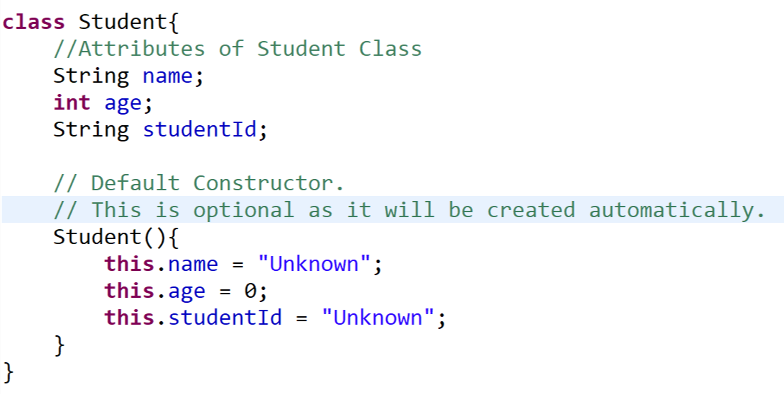
1. Default Constructor
A default constructor is a constructor that does not take any arguments. If you do not explicitly define a constructor in your class, the Java compiler provides a default constructor that initializes all member variables to their default values (e.g., 0, null, false).
Example:

Slide 8
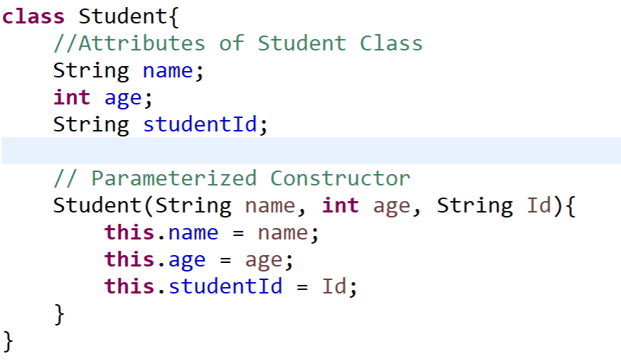
2. Parameterized Constructor:
A parameterized constructor is a constructor that takes one or more arguments. These parameters allow you to pass specific values when creating an object, enabling customized initialization.
Example:

Slide 9
this Reference:
In Java, this keyword is a reference to the current object, the object whose method or constructor is being called. It is a powerful and versatile tool that serves several important purposes in object-oriented programming.
Example:

Slide 10
Access control:
Access control in Java is a mechanism that defines the visibility and accessibility of classes, methods, and variables. It ensures that components of a program are only accessed where it is intended, promoting encapsulation and security in object-oriented programming.
Java provides four access modifiers to control the access levels:
public: Accessible from any other class.
protected: Accessible within the same package and by subclasses.
default (no modifier): Accessible only within the same package.
private: Accessible only within the same class.

Slide 11
public Access Modifier:
The access level of a public modifier is everywhere. It can be accessed from within the class, outside the class, within the package and outside the package.
The public modifier allows the class, method, or variable to be accessed from any other class in any package.

Slide 12
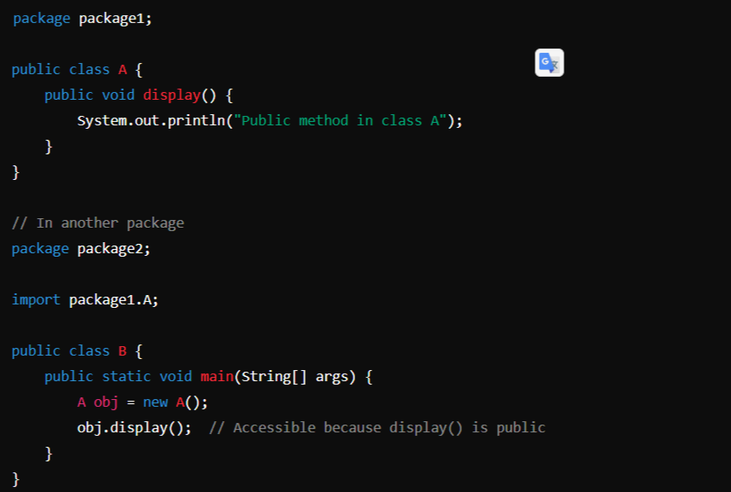
Example:

Slide 13
2. protected Access Modifier:
The access level of a protected modifier is within the package and outside the package through child class (Inheritance). If you do not make the child class, it cannot be accessed from outside the package.

Slide 14
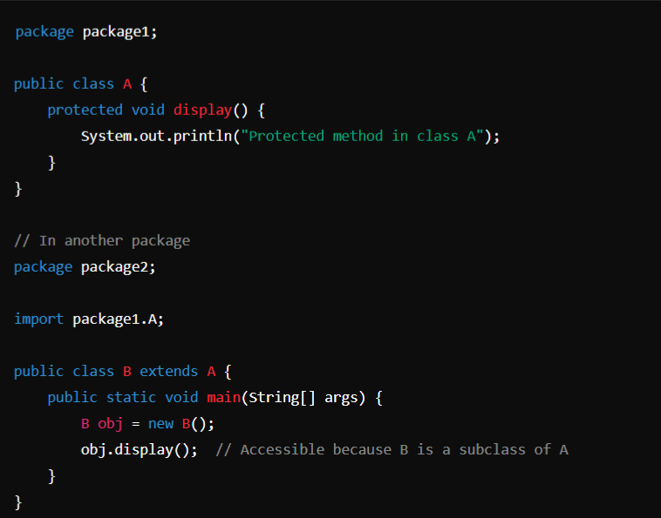
Example:

Slide 15
3. default (No Modifier) Access Modifier:
The access level of a default modifier is only within the package. It cannot be accessed from outside the package. If you do not specify any access level, it will be the default.

Slide 16
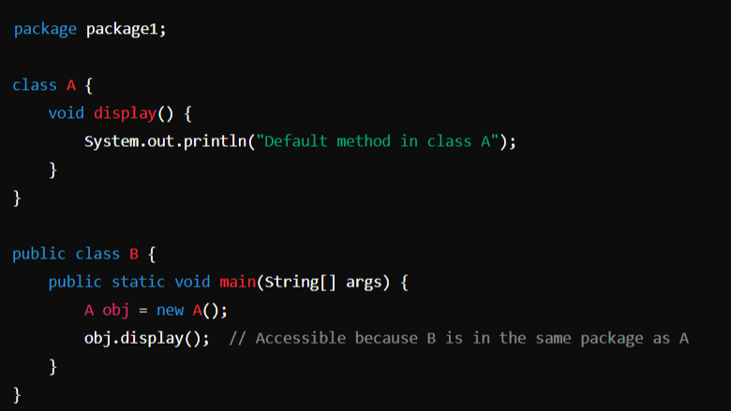
Example:

Slide 17
4. Private Access Modifier:
The access level of a private modifier is only within the class. It cannot be accessed from outside the class.

Slide 18
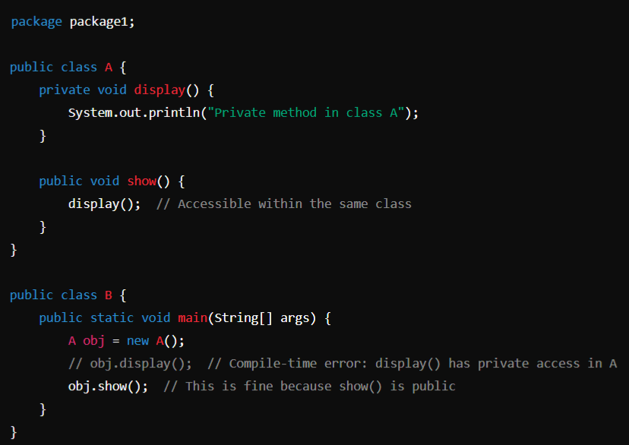
Example:

Slide 19
Conclusion:
Access Specifier | Same Class | Same Package (Child Class) | Same Package (Non-Child Class) | Other Package (Child Class) | Other Package (Non-Child Class)
Public | Yes | Yes | Yes | Yes | Yes
Protected | Yes | Yes | Yes | Yes | No
Default | Yes | Yes | Yes | No | No
Private | Yes | No | No | No | No

Slide 20
static fields and methods:
In Java, the static keyword is used to define fields (variables) and methods that belong to the class rather than to instances of the class. This means that static members are shared among all instances of the class and can be accessed without creating an instance of the class.
Key Points About static Fields and Methods:
1. Shared Across All Instances: A static field is shared among all instances of a class. It means that there is only one copy of the static field, regardless of how many objects of the class are created.
2. Accessed Without an Object: Static fields can be accessed using the class name directly (e.g., ClassName.fieldName). They can also be accessed using an object reference, but this is not recommended as it can lead to confusion.
3. Initialization: Static fields can be initialized at the point of declaration or in a static block.
4. Memory Allocation: Static fields are allocated memory only once when the class is loaded into memory.

Slide 21
Polymorphism:
In Polymorphism Poly means many, morphism means form together it says More than One Form.
Polymorphism allows objects of different classes to be treated as objects of a common superclass (through Method Overriding or Dynamic/ Late Binding). It is mainly achieved through method overriding (runtime polymorphism) and method overloading (compile-time polymorphism).
Important:
Method & Constructor Overloading & Operator Overloading (compile-time or Static polymorphism)
Method Overriding (through Inheritance) (runtime or Dynamic polymorphism)

Slide 23
overloading methods and constructors

Slide 26
Module-1: OOPS CONCEPTS AND JAVA PROGRAMMING:
OOP concepts: Classes and objects, data abstraction, encapsulation, inheritance, benefits of inheritance, polymorphism, procedural and object oriented programming paradigm.
Java programming: History of java, comments, data types, variables, constants, scope and life time of variables, operators, operator hierarchy, expressions, type conversion and casting, enumerated types, control flow statements, jump statements, simple java stand alone programs, arrays, console input and output, formatting output, constructors, methods, parameter passing, static fields and methods, access control, this reference, overloading methods and constructors, recursion, garbage collection, exploring string class.

